Slide 1
Memory Management in .Net
August 22, 2017

Slide 2
Garbage Collection

Slide 3
Garbage Collection
In and Out of Garbage Collector
GC in .Net Framework
How GC works?
Different GC algorithms
Mark sweep GC
Generational GC
Finalization Vs. Dispose
Some tips on being friendly to GC

Slide 4
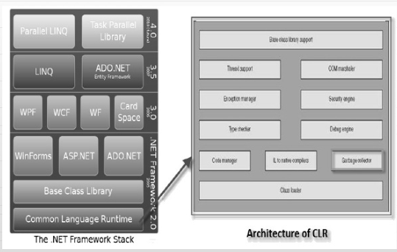
GC in .NET Framework

Slide 5
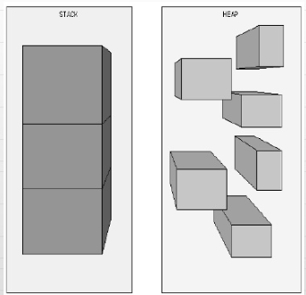
Stack Vs.Heap
The Stack and Heap are stored on RAM.
Stack takes care of its own memory management; Heap needs to be cleaned up for not used objects.
Both Stack n Heap stored on RAM.

Slide 6
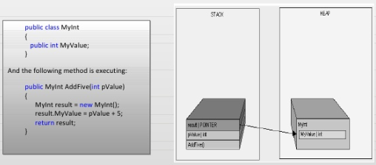
How it is decided what goes where?
Two golden rules
Reference type always goes on Heap
Value type and Pointers always goes where they are declared

Slide 7
When/How GC runs
System is low in memory
Memory is too much fragmented
There are multiple types of Garbage Collectors available
Mark sweep GC
Generational GC
Copying GC
Reference counting GC

Slide 8
Mark - Sweep GC
Algorithm
Traverse the entire memory graph starting from roots
Mark objects that are visited
Sweep (remove) all objects that are not visited
Compact

Slide 9
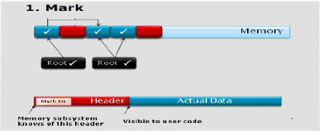
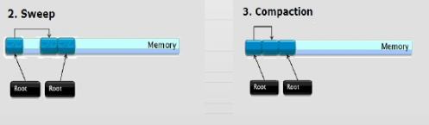
Mark - Sweep in Action

Slide 10
Compaction
Done to
Decrease fragmentation
Increase allocation speed
Increase locality of reference
Run based on fragmentation
Need to strike balance as compaction is very costly

Slide 11
Generational GC
Detailed Algorithms
Segregate objects by age into multiple generations (0, 1, 2)
Younger generation is allocated often
Failure to collect or age promotes them to higher generation
Higher generation is rarely collected

Slide 12
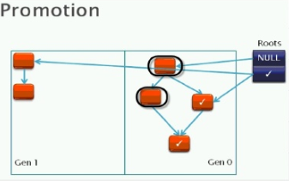
Promotion and Incremental Collection

Slide 13
Copy Collection
Instead of just marking as we trace
Copy each reachable object to new part of heap
Needs to have enough space to do this
No need for second pass
Advantages
one pass
compaction
Disadvantages
higher memory requirements

Slide 14
Generations
Current .NET uses 3 generations:
0 – recently created objects: yet to survive GC
1 – survived 1 GC pass
2 – survived more than 1 GC pass
Put lower objects lower in heap

Slide 15
Generations
During compaction, promote generations
eg. Gen 1 reachable object goes to Gen 2
Eventually:
}
Generation 0
}
Generation 1
}
Generation 2
Heap

Slide 16
Object Pinning
Pinning an object tells the GC to not move the object.
It could hurt GC performance
Pinning is done with the FIXED statement.
Pinning is only allowed in unsafe code (pointers)

Slide 17
Finalization
Recall C++ destructors: ~MyClass() { // cleanup }
called when object is deleted
does cleanup for this object
Finalize() is a destructor called internally by GC.
Dispose method is implemented explicitly by the programmer to dispose unmanaged resources.
If Dispose() method is implemented to free unmanaged resource, GC.SuppressFinalize() method is called to prevent the garbage collector from running the finalizer.

Slide 18
Finalization
More common idiom: public void Finalize() { base.Finalize(); Dispose(false); }
maybe needed for unmanaged resources
slows down GC significantly
The Dispose method is internally called when a using block is used, to free unmanaged resources.
GC.Collect() is used to explicitly call GC.

Slide 19
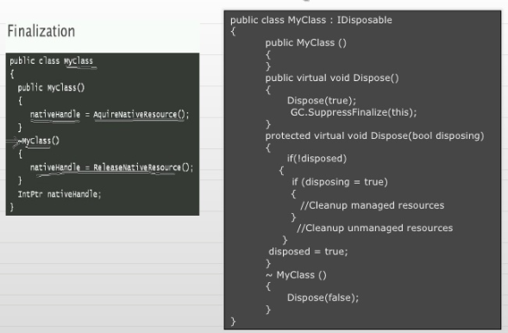
Finalization Vs. Dispose

Slide 20
Some tips of being friendly to GC
Avoid object pools
Do NOT use GC.Collect()
Be careful about un-intended object creation
Finalization
Be careful about large objects (> 85000 B)
Pinning is bad for GC performance

Slide 21

Thank You!
Manoj Ambhore
Manoj.ambhore@xoriant.com
www.xoriant.com
India
Mumbai
4th Floor, Nomura
Powai , Mumbai 400 076
Pune
5th Floor, Amar Paradigm
Baner, Pune 411 045
Kolkata
2B, 12th Floor, Tower ‘C’
Rajarhat, Kolkata 700 156
US – Corporate Headquarters
1248 Reamwood Avenue,
Sunnyvale, CA 94089
Phone: (408) 743 4400
343 Thornall St 720
Edison, NJ 08837
Phone: (732) 395 6900
UK
20 Broadwick Street
Soho, London
W1F 8HT, UK
89 Worship Street
Shoreditch,
London EC2A 2BF, UK
Phone: (44) 2079 938 955
Bangalore
4th Floor, Kabra Excelsior,
80 Feet Main Road, Koramangala 1st Block,
Bengaluru (Bangalore) 560034
Gurgaon
A/373rd Floor, Sigma Center
Gurgaon, Haryana 122 011s

